Slide 1
FUNCTION ORIENTED DESIGN

Slide 2
DESIGN STRATEGY
A good system design strategy is to organize the program modules in such a way that are easy to develop and latter change.
Structured design techniques help developers to deal with the size and complexity of programs.
Analysts create instructions for the developers about how code should be written and how pieces of code should fit together to form a program.
It is important for two reasons:
Even pre-existing code, if any, needs to be understood, organized and pieced together.
It is still common for the project team to have to write some code and produce original programs that support the application logic of the system.

Slide 3
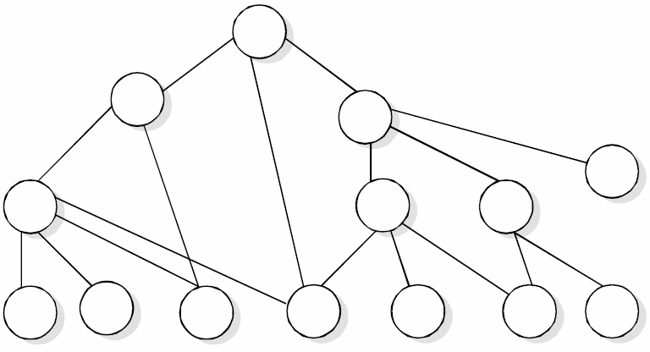
Bottom-Up Design
The modules are collected together in the form of a library

Slide 4
Top-Down Design
A top down design approach starts by
identifying the major modules of the system,
decomposing them into their lower level modules and
iterating until the desired level of detail is achieved.
This is stepwise refinement; starting from an abstract design, in each step the design is refined to a more concrete level, until we reach a level where no more refinement is needed and the design can be implemented directly.

Slide 5
Hybrid Design
For top-down approach to be effective, some bottom approach is essential for the following reasons:
To permit common sub modules.
Near the bottom of the hierarchy, where the intuition is simpler, and the need for bottom-up testing is greater, because there are more number of modules at low levels than high levels.
In the use of pre-written library modules, in particular, reuse of modules.

Slide 6
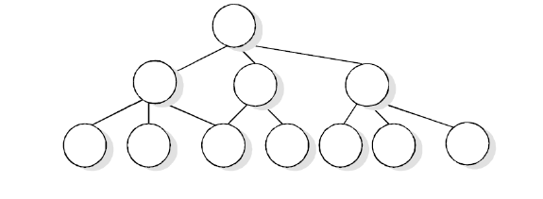
FUNCTION ORIENTED DESIGN
Function Oriented design is an approach to software design where the design is decomposed into a set of interacting units where each unit has a clearly defined function. Thus, system is designed from a functional viewpoint.
We continue the refinement of each module until we reach the statement level of our programming language.

Slide 7
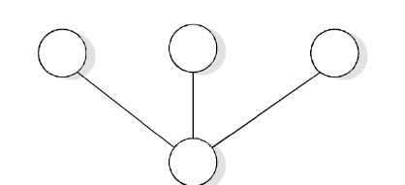
At that point, we can describe the structure of our program as a tree of refinement as in design top-down Structure.
If a program is created top-down, the modules become very specialized. As one can easily see in top down design structure, each module is used by at most one other module, its parent. For a module, however, we must require that several other modules as in design reusable structure.

Slide 8
Design Notations
Design notations are be used
during the process of design and
to represent design or design decisions.
For a function oriented design, the design can be represented
graphically or mathematically by the following:
Data flow diagrams
Data Dictionaries
Structure Charts
Pseudocode

Slide 9
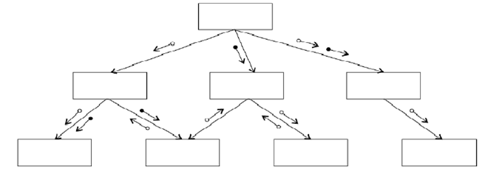
Structure Chart
It partition a system into black boxes.
A black box means that functionality is known to the user without the knowledge of internal design.
Hierarchal form of structural chart

Slide 10
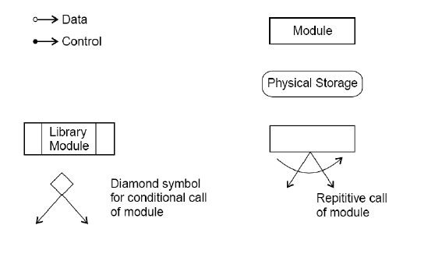
Design Notations-Structure chart notations

Slide 11
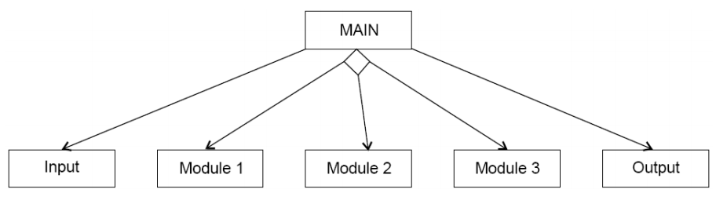
A transaction centered structure describes a system that processes a number of different types of transactions.

Slide 12
Transaction-centered structure
In the above figure the MAIN module controls the system operation its functions is to:
invoke the INPUT module to read a transaction;
determine the kind of transaction and select one of a number
of transaction modules to process that transaction, and
output the results of the processing by calling OUTPUT module.

Slide 13
Pseudocode
Pseudocode notation can be used in both the preliminary and detailed design phases.
Using pseudocode, the designer describes system characteristics using short, concise, English language phrases that are structured by key words such as It-Then-Else, While-Do, and End.

Slide 14
Functional Procedure Layers
Function are built in layers, Additional notation is used to specify details.
Level 0
Function or procedure name
Relationship to other system components (e.g., part of which system, called by which routines, etc.)
Brief description of the function purpose.
Author, date

Slide 15
Functional Procedure Layers
Level 1
Function Parameters (problem variables, types, purpose, etc.)
Global variables (problem variable, type, purpose, sharing information)
Routines called by the function
Side effects
Input/Output Assertions

Slide 16
Functional Procedure Layers
Level 2
Local data structures (variable etc.)
Timing constraints
Exception handling (conditions, responses, events)
Any other limitations
Level 3
Body (structured chart, English pseudo code, decision tables, flow charts, etc.)

Slide 17
Software Design- Definitions
i. Design entity. An element (Component) of a design that is
structurally and functionally distinct from other elements and
that is separately named and referenced.
ii. Design View. A subset of design entity attribute information
that is specifically suited to the needs of a software project
activity.
iii. Entity attributes. A named property or characteristics of a
design entity. It provides a statement of fact about the entity.
iv. Software design description (SDD). A representation of a
software system created to facilitate analysis, planning,
implementation and decision making.

Slide 18
Purpose of an SDD
The SDD shows how the software system will be structured to
satisfy the requirements identified in the SRS.
It is basically the translation of requirements into a description of the software structure, software components, interfaces, and data necessary for the implementation phase.
Hence, SDD becomes the blue print for the implementation activity.
Design Description Information Content
Introduction
Design entities
Design entity attributes

Slide 19
The attributes and associated information items are defined in the following subsections:
a) Identification
b) Type
c) Purpose
d) Function
e) Subordinates
f) Dependencies
g) Interface
h) Resources
i) Processing
j) Data

Slide 20
Design Description Organization
Each design description writer may have a different view of what
are considered the essential aspects of a software design.
A recommended organization of the SDD into separate design
views to facilitate information access and assimilation is given in
next table.

Slide 21
Design View | Scope | Entity attribute | Example representation
Decomposition description | Partition of the system into design entities | Identification, type purpose, function, Subordinate | Hierarchical decomposition diagram, natural language
Dependency Description | Description of relationships among entities of system Resources | Identification, type, purpose, dependencies, Resources | Structure chart, data flow diagrams, transaction diagrams
Interface Description | List of everything a designer, developer | Identification, function, interfaces | Interface files, parameter tables
Detail Description | Description of the internal design details of an entity | Identification, Processing data. | Flow charts, PDL etc.

Slide 22
Multiple-Choice Questions
Choose the option that does not define Function Oriented Software Design. a) It consists of module definitions b) Modules represent data abstraction c) Modules support functional abstraction d) None of the mentioned
Which of the following is a complementary approach to function-oriented approach ? a) Object oriented analysis b) Object oriented design c) Structured approach d) Both Object oriented analysis and design

Slide 23
Multiple-Choice Questions
3. Function-oriented design techniques starts with functional requirements specified in a) SDD b) SRS c) All of the mentioned d) None of the mentioned
4. Structured Analysis is based on the principles of a) Top-down decomposition approach b) Divide and conquer principle c) Graphical representation of results using DFDs d) All of the mentioned
5. Which of the following is/are true with respect to functions ? a) A function such as “search-book” is represented using a circle b) Functions represent some activity c) Function symbol is known as a process symbol or a bubble in DFD d) All of the mentioned

Slide 24
Solutions
1. b
2. d
3. b
4. d
5. d

